Slide 1
Chapter 12: I/O, 8255 and Device Interfacing, Part 4
CSE 3442
Tom Rethard

Slide 2
Interfacing a Stepper Motor
Disk drives, dot matrix printers, tobotics in general
Permanent magnet motor
  Permanent magnet rotor (shaft)
  4+ stator windings
  Center tap to control direction of current in each coil.
Motion is not continuous like a normal motor
  In fixed increments (steps)

Slide 3
Stepper Motor Terms
Step Angle
  How far (angular motion) the motor turns with each pulse
  Depends on construction of motor
  = 360/steps per revolution
Steps per Second and RPM
  SPS = (RPM * Steps per revolution)/60
Tooth
  The angle moved by one complete sequence of steps

Slide 4
Stepper Motor Terms
Motor Speed
  Measured in steps/second
Holding Torque
  Force needed to turn shaft with rated voltage and current applied
  Measured in ounce-inch or kg-cm

Slide 5
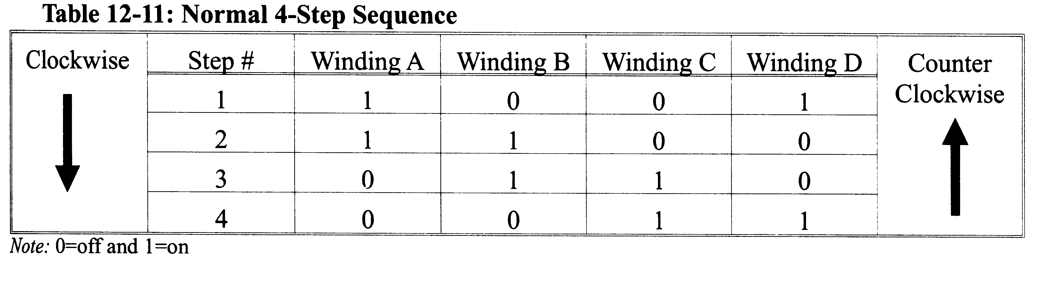
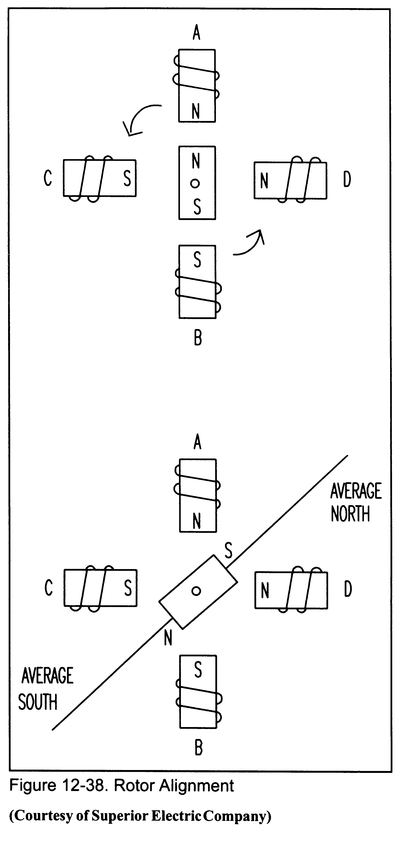
Rotor Alignment

Slide 6
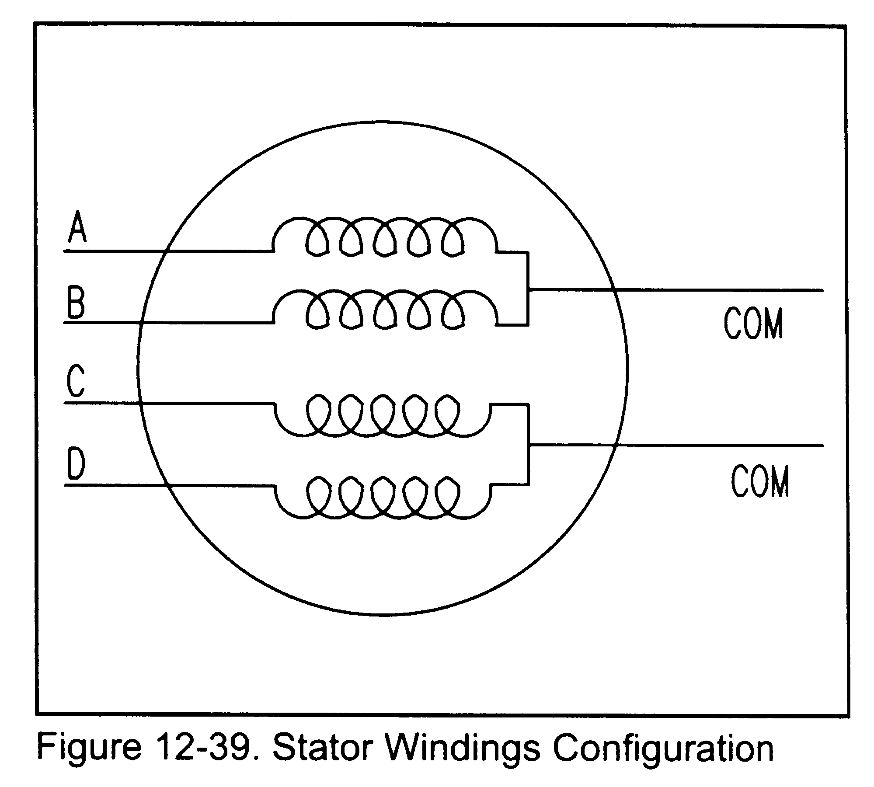
Stator Windings

Slide 7
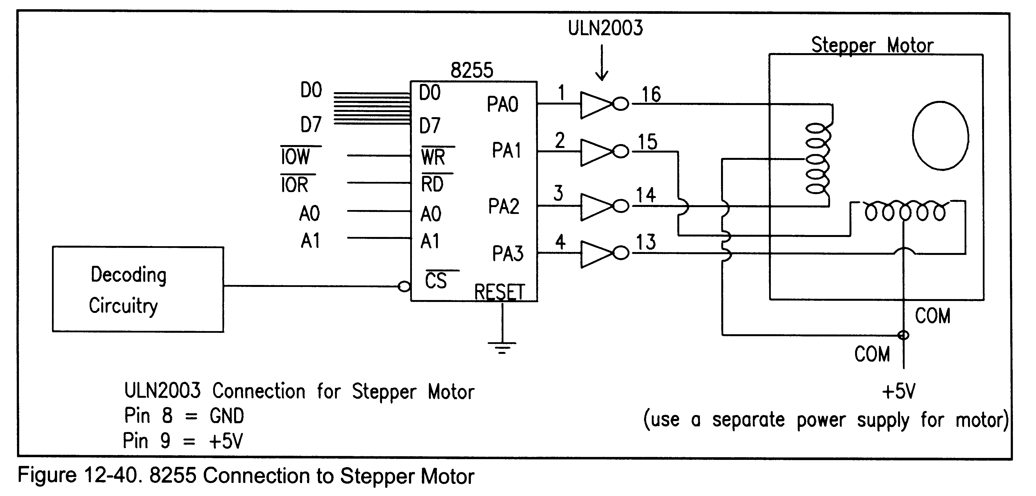
Connecting the Motor

Slide 8
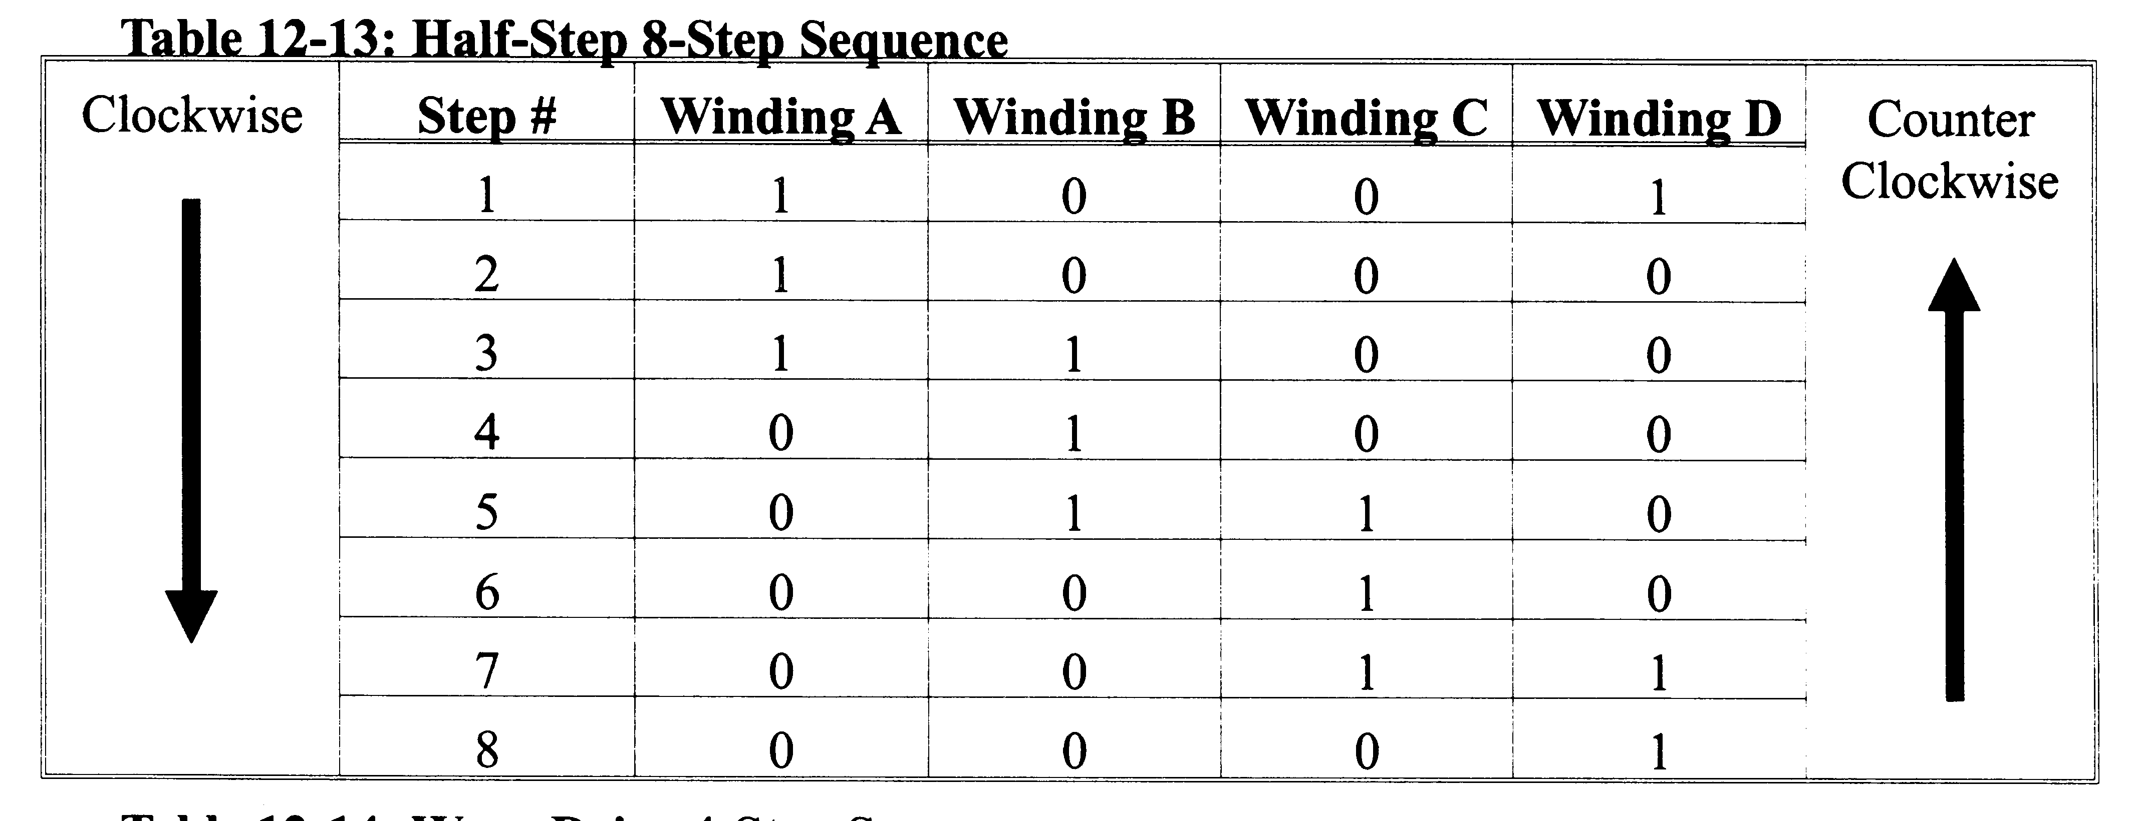
Half-Step 8-Step Sequence

Slide 9
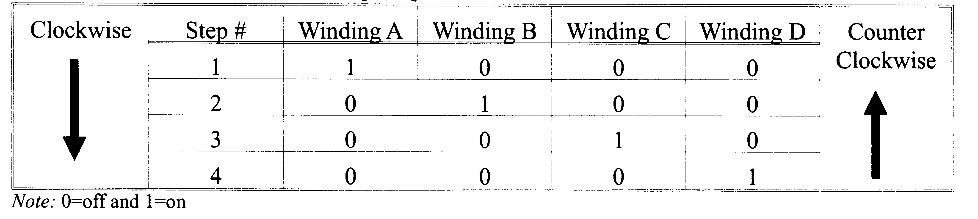
Wave-Drive 4 Step Sequence

Slide 10
Interfacing ADC and Sensors
ADC Devices
  Analog-to-digital/digital-to-analog
  Example ADC804

Slide 11
ADC804
Analog-to-digital (National Semiconductor, and others)
Pinouts:
  CS: Chip Select
  RD: Read input
  WR: Write output
  CLK IN and CLK R: clock control

Slide 12
ADC804 Pinouts
CS
  Chip Select
  Just like every other CS
  Active low
RD
  Read
  Input, active low
  When CS=0, a high-to-low pulse on RD copies the data to D0=D7
  Also referred to as “output enable”

Slide 13
ADC 804 Pinouts
WR
  Write
  Also “start conversion”
  Active low input
  If CS=0 when WR makes low-to-high transition, starts converting the analog input value V_{in} to 8 bit number.

Slide 14
ADC 804 Pinouts
CLK IN and CLK R
  Can use external or internal clock
  External clock
    Connect CLK IN to external clock
  Internal clock
    Connect CLK IN and CLK R with a capacitor and a resistor
    Frequency: f=1/1.1RC
      Typical: R=10K and C = 150pF, yielding 606Khz, with conversion time of 110μs

Slide 15
ADC 804 Pinouts
INTR
  Interrupt or “end of conversion”
  Output, active low, normally high
  Goes low when conversion is finished
D0-D7
  Binary data
  D7 is msb
  Output calculated as
    D_{out} = (V_{in}/stepsize)

Slide 16
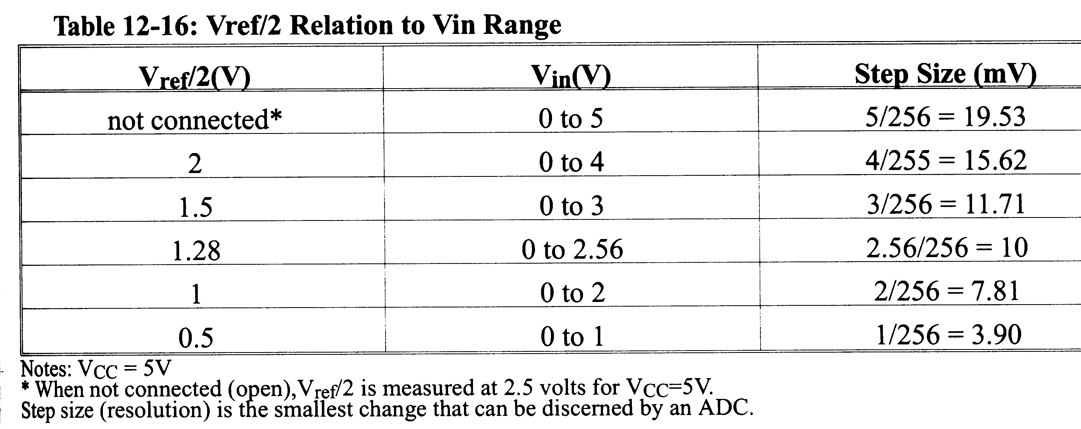
V_{ref/2} Relation to V_{in} Range

Slide 17
ADC 804 Pinouts - Voltages
V_{in}(+) and V_{in}(-)
  Differential analog inputs
  V_{in}(-) often connected to ground
V_{cc}
  +5v power supply
  Used as reference voltage when V_{ref/2} not connected
V_{ref/2}
  Input voltage for reference
  When open, analog input is 0 – 5 v
  Otherwise, the range is 0 – 2* V_{ref/2}

Slide 18
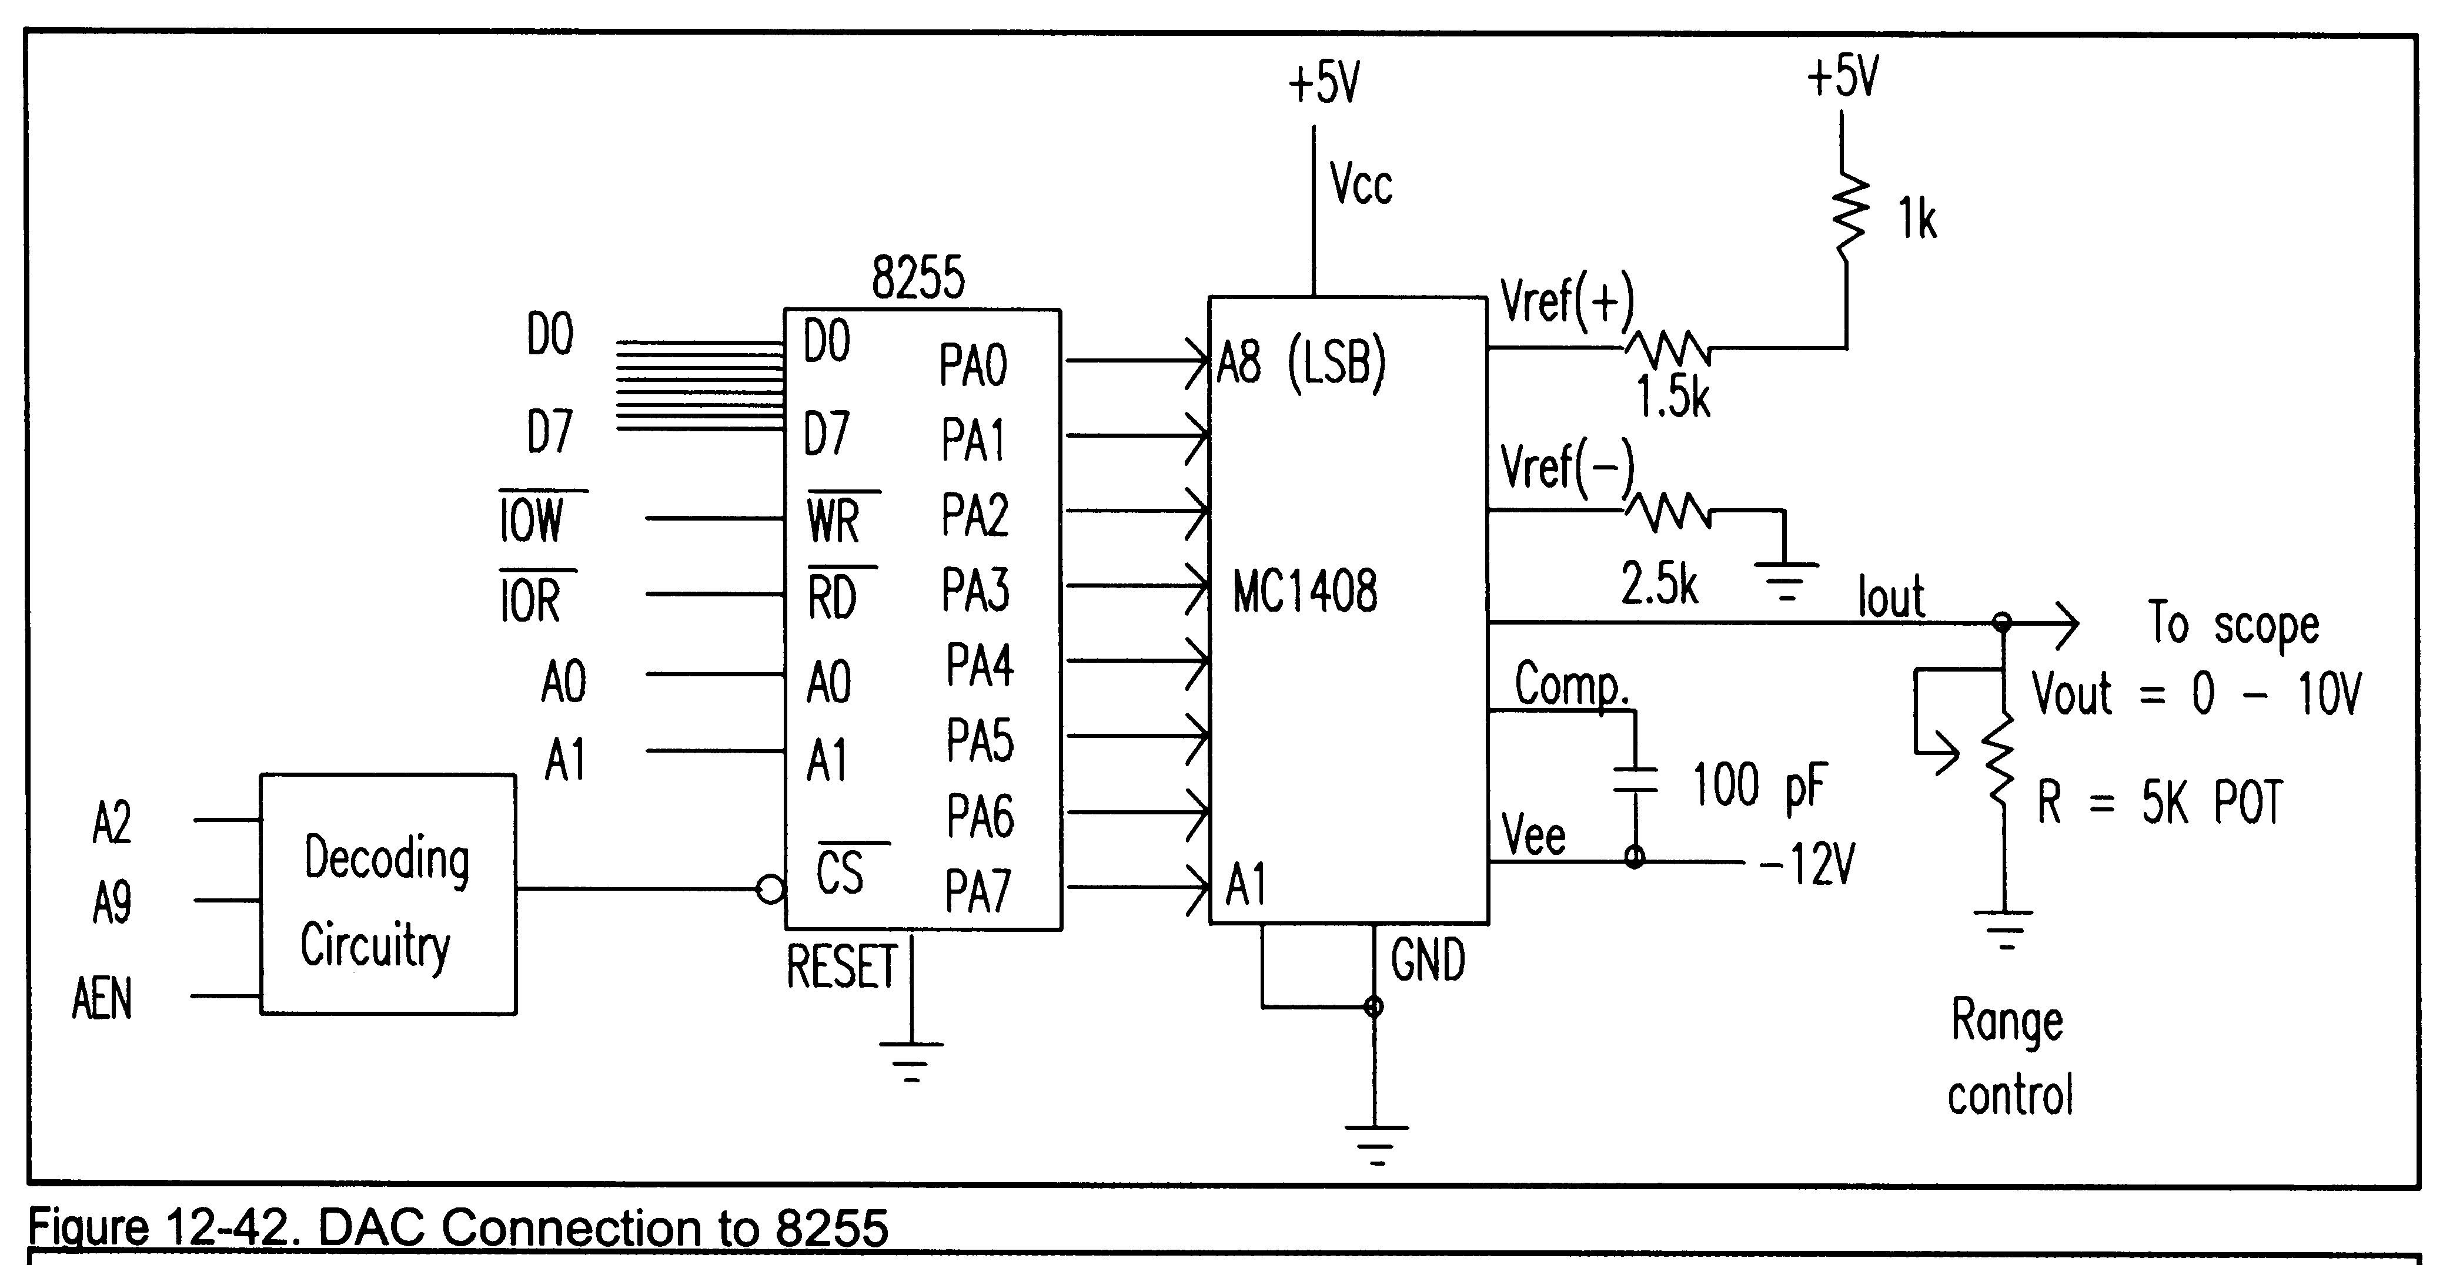
DAC Connection

Slide 19
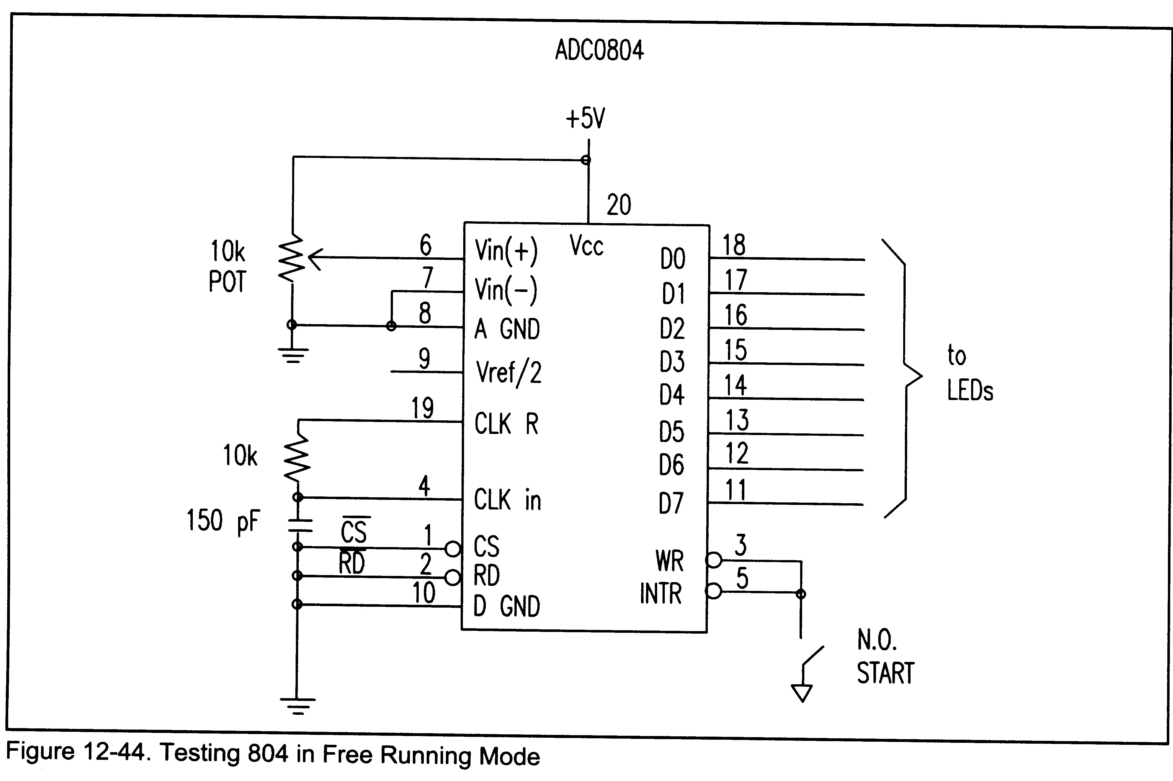
Wiring an 804

Slide 20
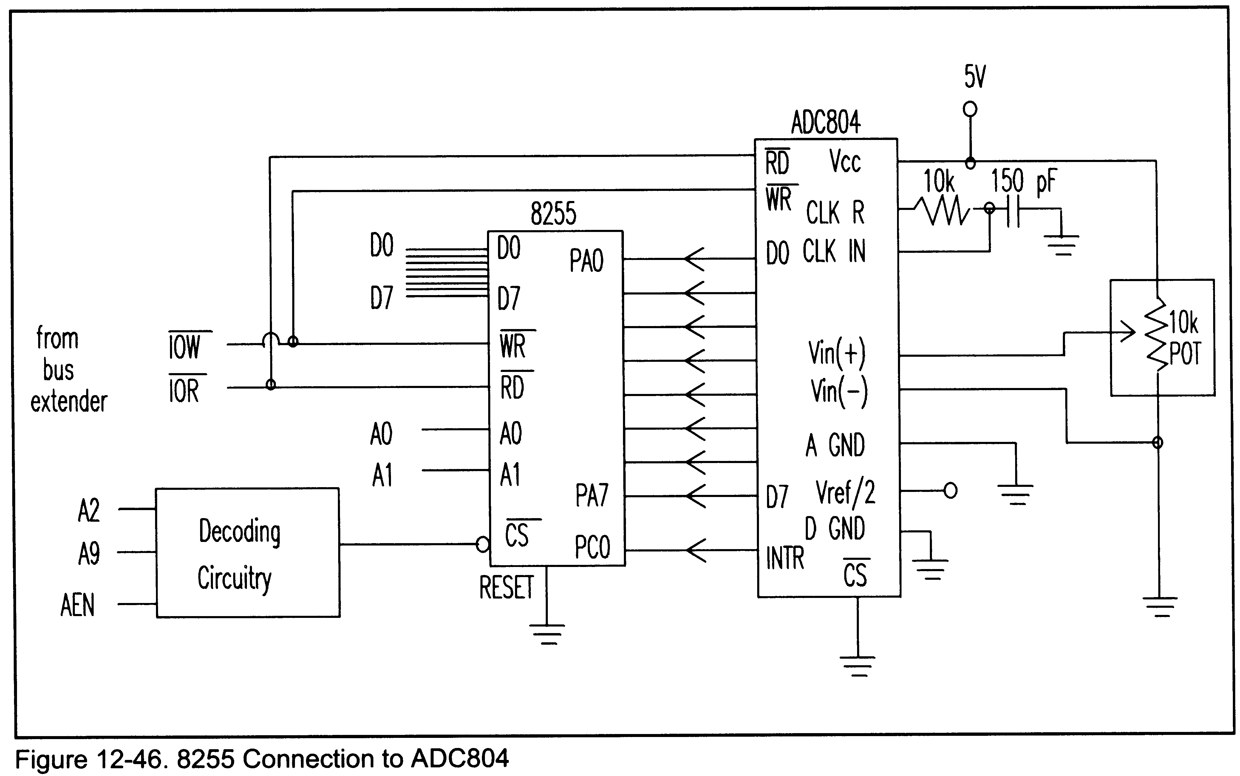
8255 Connection to 804

Slide 21
Connecting a Temperature Sensor
Transducers convert physical measurements to voltages
  Light intensity
  Fluid flow
  Speed
  Temperature
Thermistors respond by changing resistance based on external temperature
  Two common series: LM34 and LM35

Slide 22
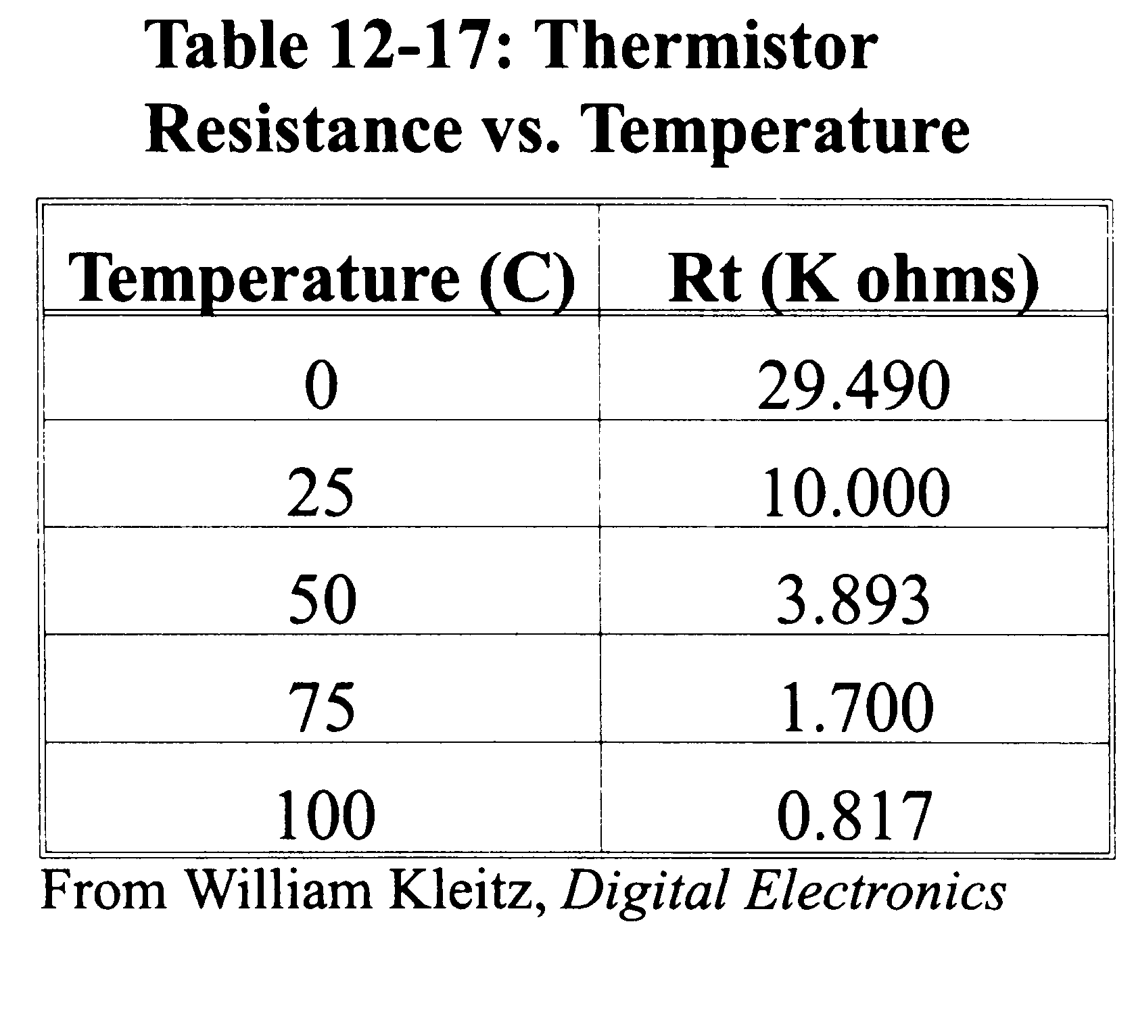
Thermistor Resistance vs Temp

Slide 23
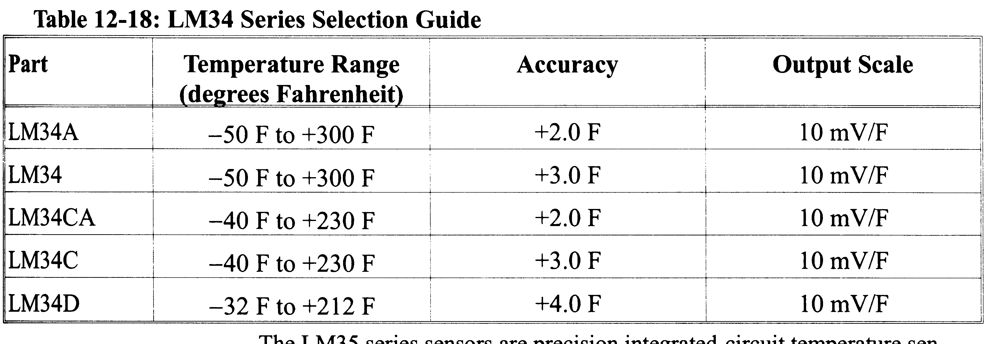
LM 34 Selection Guide
No external calibration
Output is 10mV for each degree Fahrenheit

Slide 24
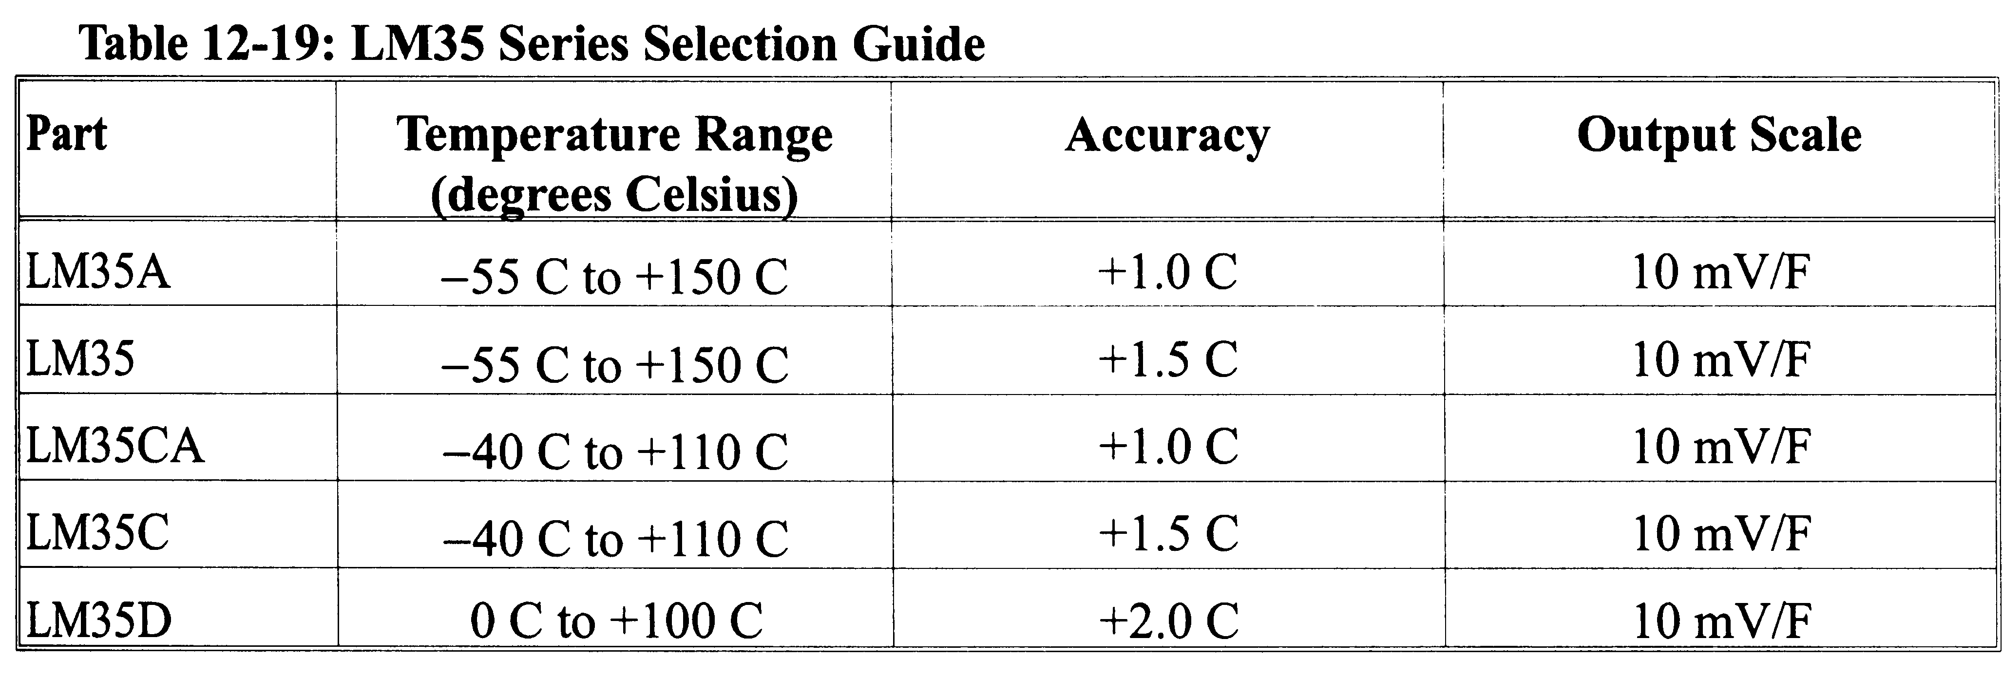
LM35 Selection guide
No external calibration
10mV for each degree Celsius

Slide 25
Signal Conditioning
Conversion of the sensor’s output to a form suitable for an ADC
Can be current-to voltage conversion or signal amplification
Can be views as a type of range conversion

Slide 26
Signal Conditioning Example
LM35D thermistor has a range of 0-100 Celsius
ADC804 has 256 increments
Full scale output is 10*256 or 2560mV
We need a full-scale V_{out} of 2.56V
  This is the reference voltage
  Set V_{ref/2} to 1.28V
Can use Zener diodes to fix voltage across a pot

Slide 27
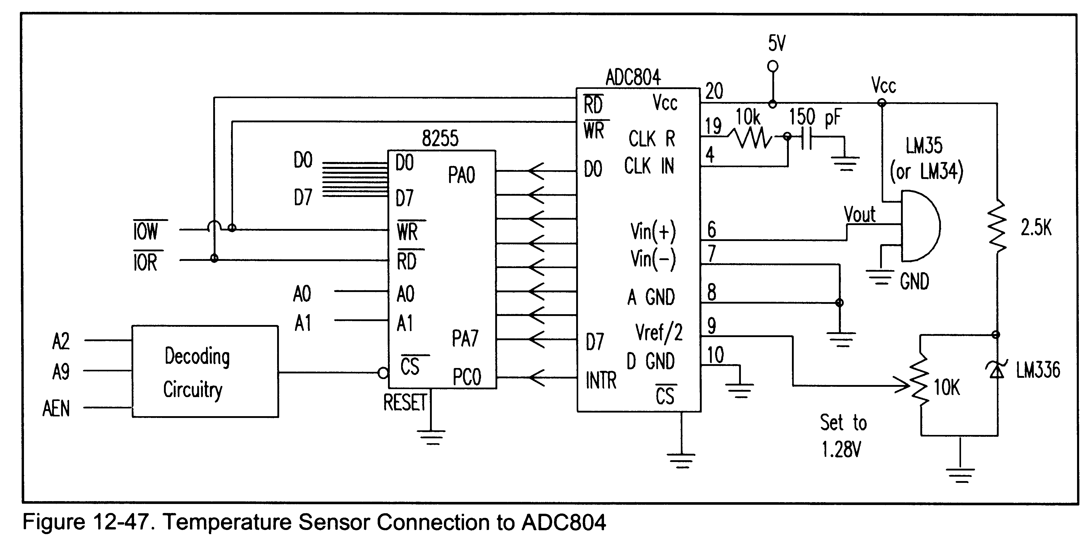
Connecting a Temperature Sensor

